Slide 1
Bayesian classification methods

Slide 2

Roadmap
Background
Probability Basics
Probabilistic Classification
Naïve Bayes – Principle and Algorithms
Example: Play Tennis
Example 2

Slide 3
Probability Basics

Slide 4
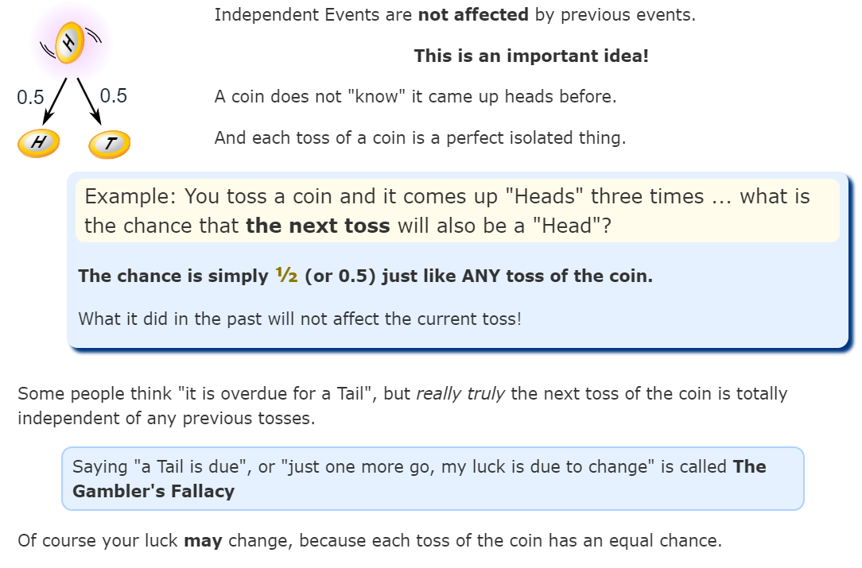
Independent Events

Slide 5
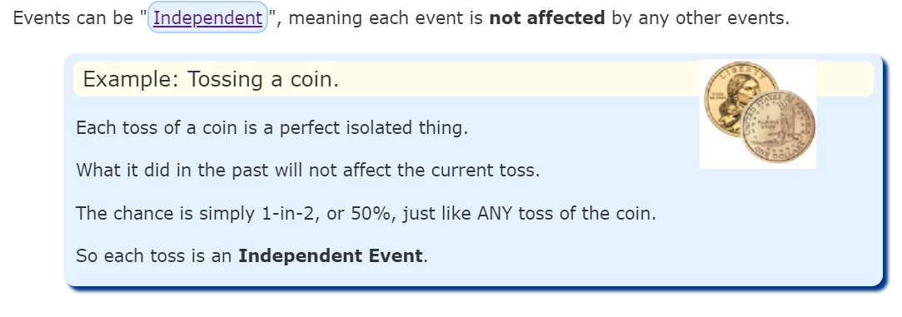
Independent Events

Slide 6
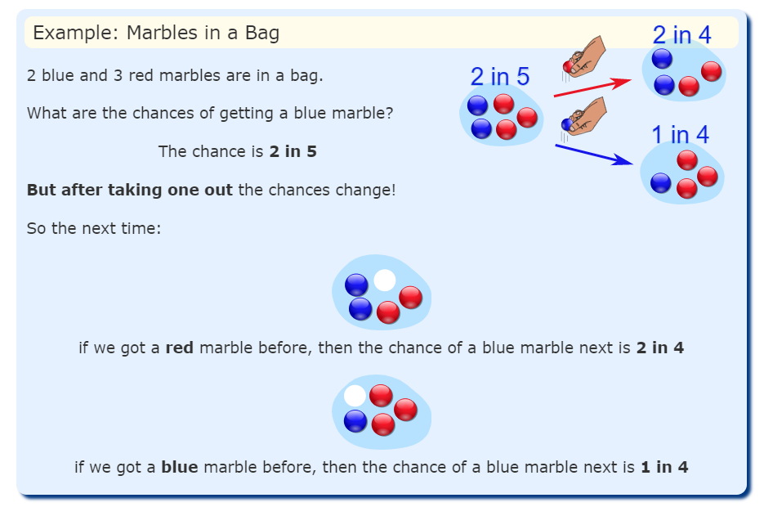
Dependent Events

Slide 7
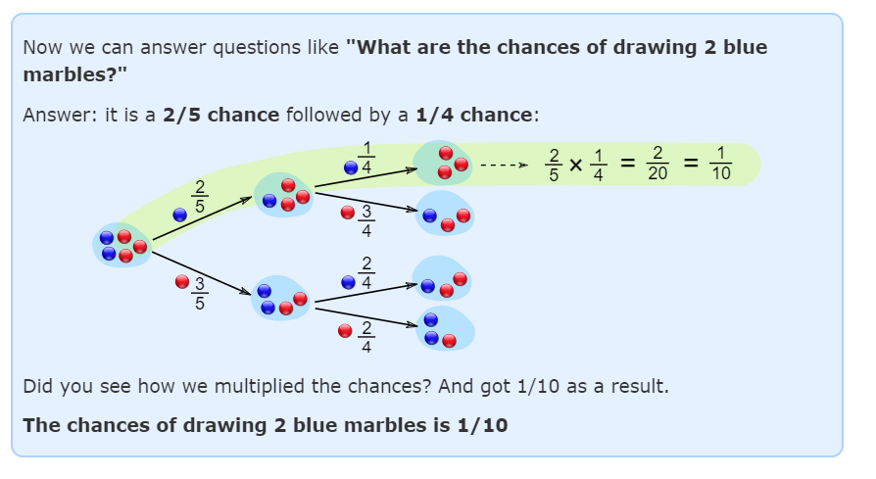
Dependent Events

Slide 8
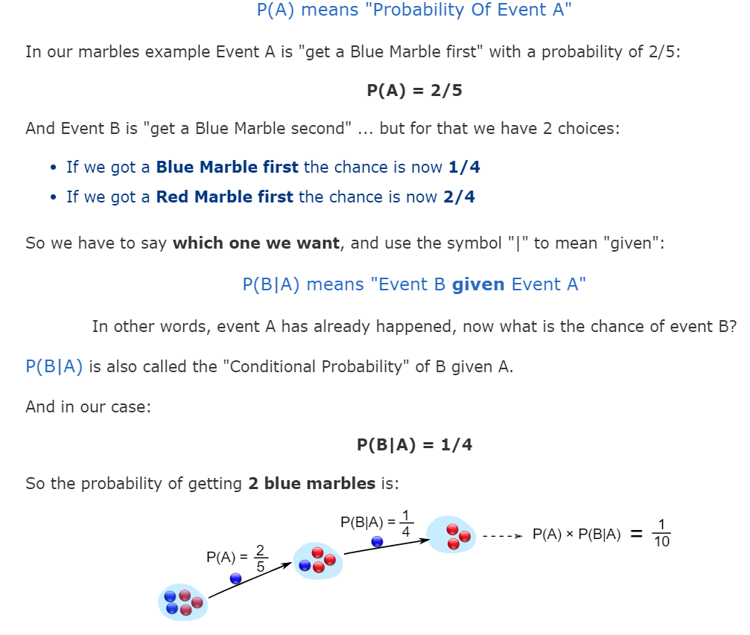
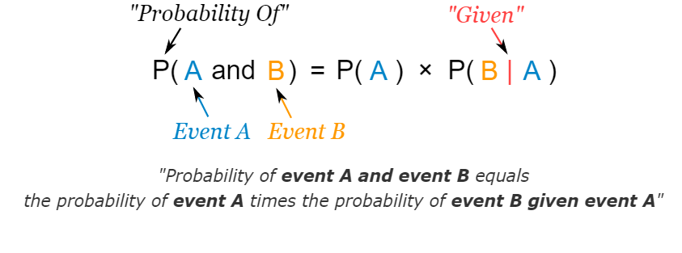
Notation

Slide 9
Example – 1
Drawing 2 Kings from a Deck

Slide 10
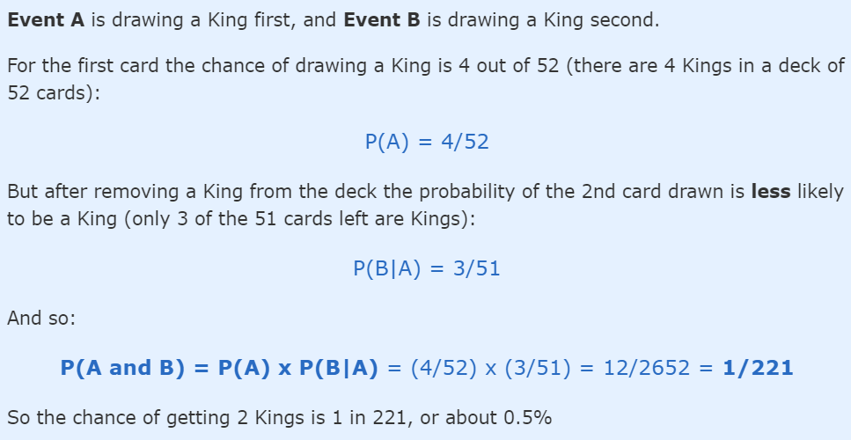
Example – 1
Drawing 2 Kings from a Deck

Slide 11
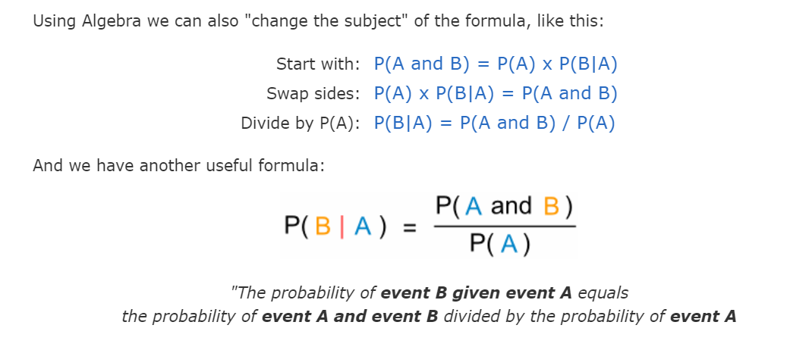
Conditional Probability

Slide 12
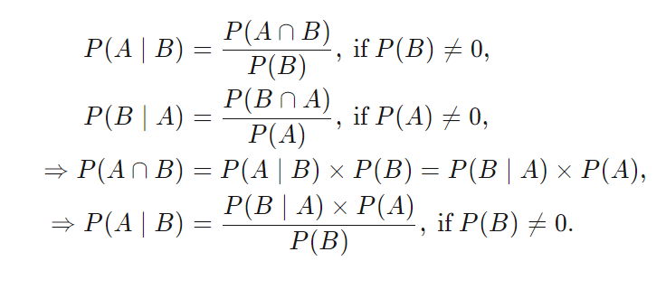
Deriving Bayes' Theorem
Bayes' theorem centers on relating different conditional probabilities

Slide 13
Probabilistic Classification
Establishing a probabilistic model for classification
Discriminative model
What is a discriminative Probabilistic Classifier?
Discriminative
Probabilistic Classifier
Example
C₁ – benign mole
C₂ - cancer

Slide 14
Discriminative Classifiers
Discriminative Classifiers learn what the features in the input are most useful to distinguish between the various possible classes.
So, if given images of dogs and cats, and all the dog images have a collar, the discriminative models will learn that having a collar means the image is of dog.
An example of a discriminative classifier is logistic regression.
Mathematically, it directly calculates the posterior probability P(y|x) or learn a direct map from input x to label y. So, these models try to learn the decision boundary for the model.

Slide 15
Probabilistic Classification
Establishing a probabilistic model for classification (cont.)
Generative model
Probability that this fruit is an orange
Probability that this fruit is an apple
Generative
Probabilistic Model
for Class 1
Generative
Probabilistic Model
for Class 2
Generative
Probabilistic Model
for Class L

Slide 16
Generative Classifiers
Generative Classifiers tries to model class, i.e., what are the features of the class.
In short, it models how a particular class would generate input data. When a new observation is given to these classifiers, it tries to predict which class would have most likely generated the given observation.
Such methods try to learn about the environment. An example of such classifiers is Naive Bayes
Generative models try to learn the joint probability distribution, p(x,y), of the inputs x and label y, and make their prediction using Bayes rule to calculate the conditional probability, p(y|x), and then picking a most likely label.

Slide 17
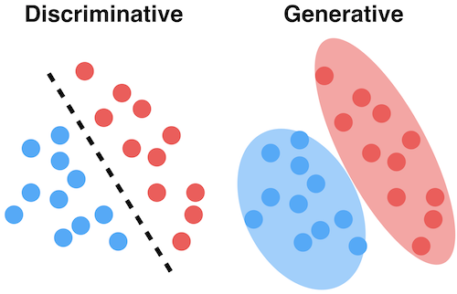
Generative Vs Discriminative

Slide 18
Background: methods to create classifiers
There are three methods to establish a classifier
a) Model a classification rule directly
Examples: k-NN, decision trees, perceptron, SVM
b) Model the probability of class memberships given input data
Example: perceptron with the cross-entropy cost
c) Make a probabilistic model of data within each class
Examples: naive Bayes, model based classifiers
a) and b) are examples of discriminative classification
c) is an example of generative classification
b) and c) are both examples of probabilistic classification

Slide 19
Naïve Bayes
For a class, the previous generative model can be decomposed by n generative models of a single input.
Bayes classification
Difficulty: learning the joint probability
Naïve Bayes classification
Assumption that all input attributes are conditionally independent!
MAP classification rule: for
Product of individual probabilities

Slide 20
Naïve Bayes Algorithm
Naïve Bayes Algorithm (for discrete input attributes) has two phases
1. Learning Phase: Given a training set S,
Output: conditional probability tables; for elements
2. Test Phase: Given an unknown instance ,
Look up tables to assign the label c* to X’ if
Learning is easy, just create probability tables.
Classification is easy, just multiply probabilities

Slide 21
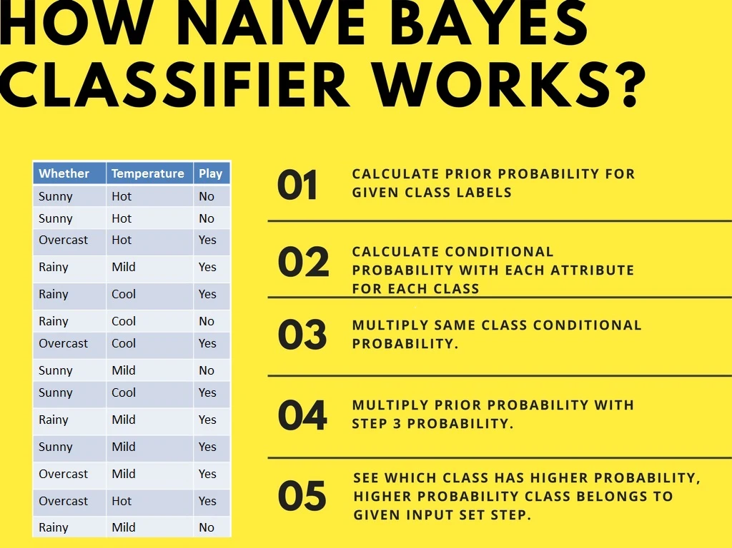
How Naïve Bayes Classifier works?

Slide 22
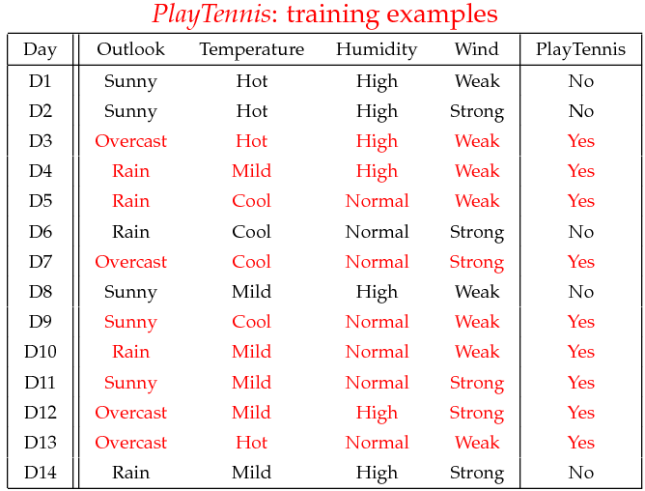
Tennis Example
Example: Play Tennis

Slide 23
P(Play=Yes) = 9/14
P(Play=No) = 5/14

Slide 24
Outlook | Play=Yes | Play=No
Sunny | 2/9 | 3/5
Overcast | 4/9 | 0/5
Rain | 3/9 | 2/5

Slide 25
Temperature | Play=Yes | Play=No
Hot | 2/9 | 2/5
Mild | 4/9 | 2/5
Cool | 3/9 | 1/5

Slide 26
Humidity | Play=Yes | Play=No
High | 3/9 | 4/5
Normal | 6/9 | 1/5

Slide 27
Wind | Play=Yes | Play=No
Strong | 3/9 | 3/5
Weak | 6/9 | 2/5

Slide 28
Given a new instance of variable values,
x’=(Outlook=Sunny, Temperature=Cool, Humidity=High, Wind=Strong)
P(Outlook=Sunny|Play=Yes) = 2/9
P(Temperature=Cool|Play=Yes) = 3/9
P(Huminity=High|Play=Yes) = 3/9
P(Wind=Strong|Play=Yes) = 3/9
P(Play=Yes) = 9/14
P(Outlook=Sunny|Play=No) = 3/5
P(Temperature=Cool|Play==No) = 1/5
P(Huminity=High|Play=No) = 4/5
P(Wind=Strong|Play=No) = 3/5
P(Play=No) = 5/14
Use the MAP (maximum a posteriori probability) rule to calculate Yes or No
P(Yes|x’): [P(Sunny|Yes)P(Cool|Yes)P(High|Yes)P(Strong|Yes)]P(Play=Yes) = 0.0053
P(No|x’): [P(Sunny|No) P(Cool|No)P(High|No)P(Strong|No)]P(Play=No) = 0.0206
Given the fact P(Yes|x’) < P(No|x’), we label x’ to be “No”.

Slide 29
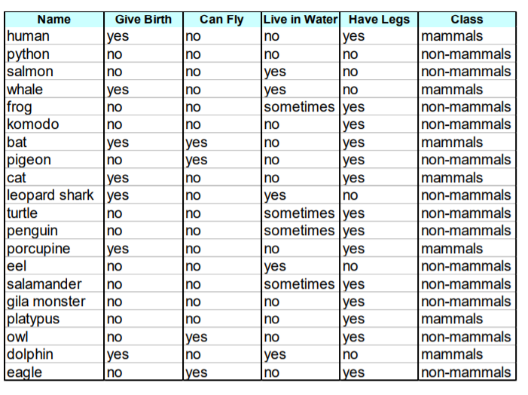

Example 2

Slide 30
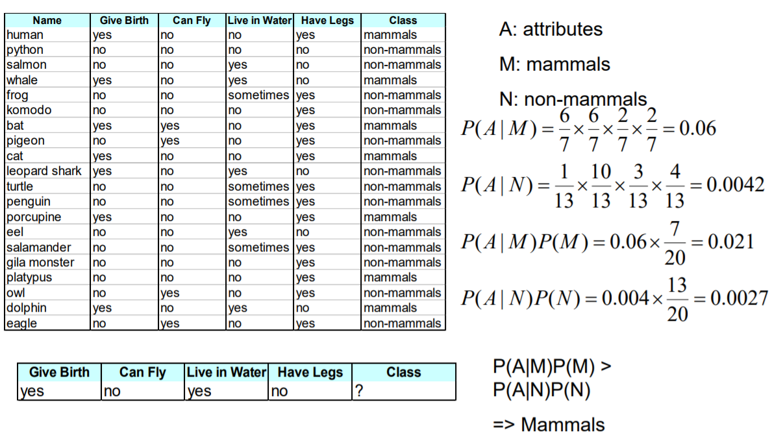
Example 2

Slide 31
Naive Bayes
Naive Bayes (NB) is ‘naive’ because it makes the assumption that features of a measurement are independent of each other.

Slide 32
Extra - Bayes' Theorem
Bayes’ Theorem is a way of finding a probability when we know certain other probabilities.
P(A|B) = P(A) P(B|A) / P(B)
Which tells us: | how often A happens given that B happens, written P(A|B)
When we know: how often B happens given that A happens, written P(B|A)
and how likely A is on its own, written P(A)
and how likely B is on its own, written P(B)

Slide 33
Extra - Bayes' Theorem

Slide 34
Extra - Bayes' Theorem

Slide 35
Extra - Bayes' Theorem

Slide 36
Extra - Bayes' Theorem

Slide 37
False Positives and False Negatives – Previous Example

Slide 38
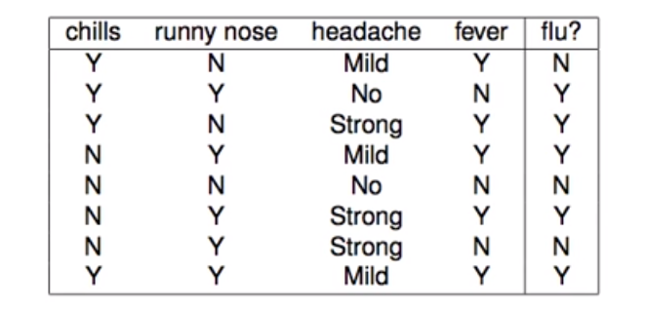
Example - 3
Given the data for symptoms and whether patient have flu or not, classify following:
x = (chills = Y, runny nose = N, headache = mild, fever = Y)

Slide 39
Thanks

